Slide 1
Victoria community School Relationships Education
Consultation with our School Community
Any questions, please put these in the chat box and Mrs Manners or Miss Mewis will respond.

Slide 2
New Guidance
20 years since the last review of the curriculum- the world (and how we interact with each other) has changed
New- Relationships Education in Primary Schools
Previous recommendations for teaching Personal, Social, Health Education, are now part of the National Curriculum
Sex Education in Primary Schools remains optional, though in year 6 the science curriculum forms part of what might be considered as sex education- puberty and reproduction

Slide 3
Relationship Education
Relationships Education includes:
• Families and people who care for me
• Different types of families; stable and caring relationships
• Marriage
• Caring and respectful friendships and relationships
• Bullying
• Stereotypes and permission seeking
• Online relationships
• Being safe

Slide 4
Science Curriculum
As part of the Science curriculum we teach the following statutory objectives that build understanding about growth and reproduction:
Year One and Two
Identify, name, draw and label the basic parts of the human body. Notice that animals, including humans, have offspring which grow into adults; they should not be expected to understand how reproduction occurs. Understand the importance of exercise and hygiene.
Year Five and Year Six
Describe the life process of reproduction in some plants and animals. They should learn about the changes experienced in puberty. Recognise that living things produce offspring of the same kind.

Slide 5
Health Education (Included in national science curriculum)
Mental and Physical Health Education includes:
• Mental wellbeing
• Bullying
• Internet safety and harms
• Physical health and fitness
• Healthy eating
• Drugs, alcohol and tobacco
• Health and prevention
• Basic first aid and call emergency services
• Changing adolescent body
Drug Education
These aspects are statutory.

Slide 6
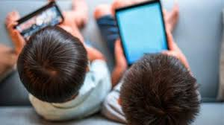
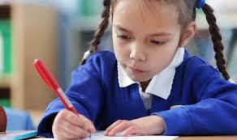
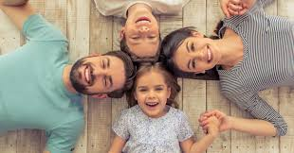
Where and how did you learn about the human body and relationships? For young people, their learning comes from…
TV
Internet
Mobile phones
School
Friends & Older Siblings
Parents & Carers

Slide 7
Why is Relationship and Health Education important?
Entitlement-basic knowledge of their own bodies
Puberty is starting earlier- for some children by age 9
Safeguarding
Grooming
Child Sexual Exploitation
Abuse

Slide 8
What is effective
Relationships Education (RSE)?
Age appropriate
Based on needs of pupil (see later slides)
Progressive
Inclusive
Delivered by trained staff in a safe environment
Prepares children adequately for puberty in a timely way
Prepares children for adult life
Promotes positive relationships

Slide 9
The role of parents
The role of parents in the development of their children’s understanding about PSHE and relationships Education is vital. Parents are the first teachers of their children. They have the most significant influence in enabling their children to grow and mature and to form healthy relationships.

Slide 10
Your rights as a parent:
To be informed of the RSE curriculum and policy
To be consulted about changes to these
To withdraw your child from Sex education lessons (that are outside of/ additional to the Science National Curriculum)

Slide 11
Next Steps:
Please look at the materials on the school website.
Please respond to the survey.
We are particularly interested in your views about when to tackle different concepts and any areas you might like further support with at home.
We are aware that there will be differences of opinion, but we will take your views into account when we finalise our policy and curriculum plan.

Slide 12
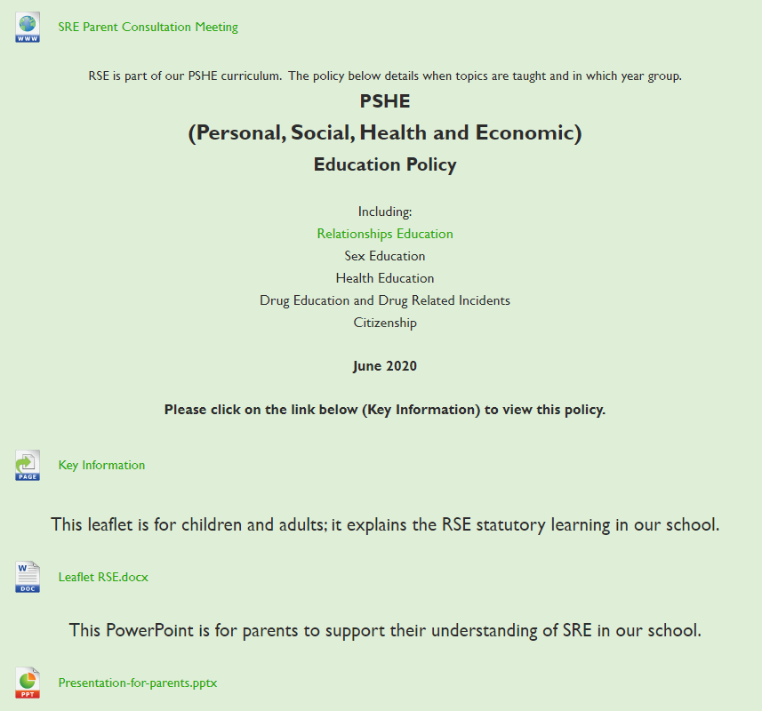
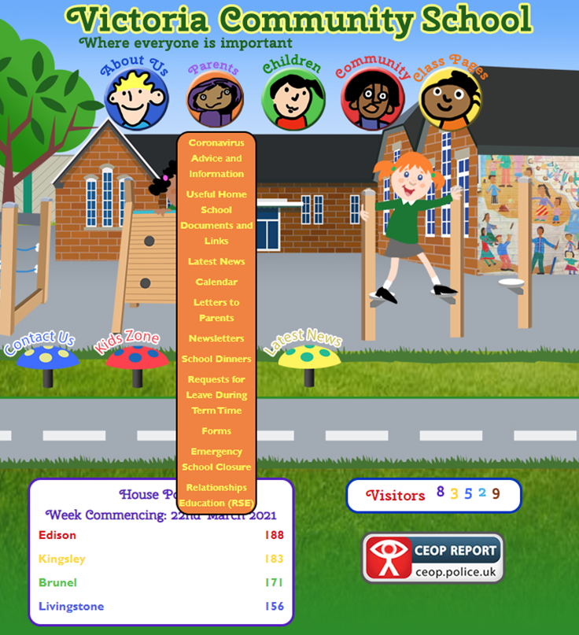
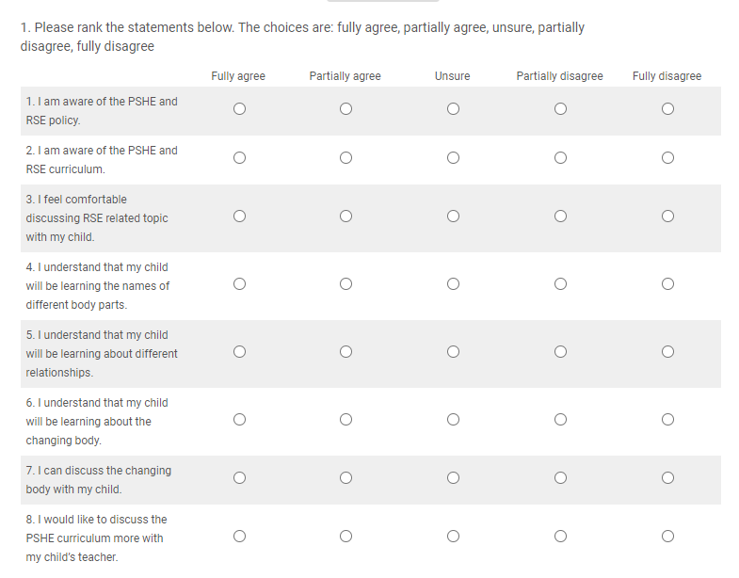

Slide 13
Thank you very much for attending this meeting.
If you have any questions that you would like to be answered please press the
If you have any further questions, please speak with your child’s teacher or any member of staff.

